Slide 1





Sharing good practice
From a Trauma Informed School perspective
Nicola Anderson & Jane Bogges, (Leicester City Primary PRU)
Paul Carr & Beth Pope Social Emotional & Mental Health Team (SEND SS; Leicester City)
Lewis Pegg (Leicestershire Pupil Referral Unit).

Slide 2
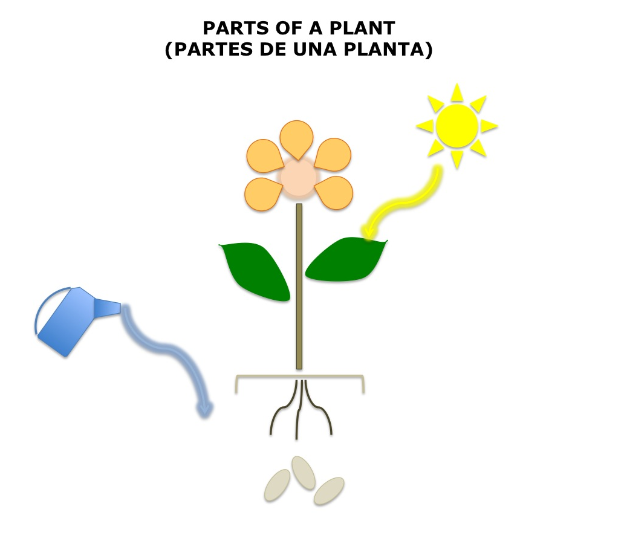
Flower Formulation
Allows us to see the ‘whole child’
This will help us to set / use strategies for their different needs
Behaviours
Critical Incident
Compensatory strategies
Rules & Assumptions
Core belief
Unmet needs

Slide 3

Angry outbursts, avoidance:
“I hate school, I hate life, everyone hates me, I hate myself, I hate everyone.”
Punitive consequence= reinforced belief
Focus on behaviour = limited change
Behaviours
Openly criticised/ ‘Left Out’ /Over challenged = I feel worthless again…
Critical Incident
Focus on emotional response = gradual change
I want my teacher’s attention
I must do everything by myself
I can not make mistakes / I must avoid tricky activities: I can’t cope
Proactive attempts to subdue these = reduced ‘crises’
Compensatory strategies
Rules & Assumptions
I can’t trust other people
I will get hurt
People don’t care about me
I am unsafe
I am worthless
Focus on experience = longer lasting change
Core belief
Change of experience = de-activation of IWM and change to a new one
Unmet needs
Lack of empathy
Demanding parent
Not listened to
Not allowed to express emotions
Physically unsafe environment

Slide 4
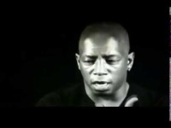

Slide 5

“Connect before you correct”
Dan Hughes (2006)

Slide 6
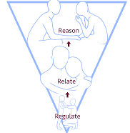
Sensory & Learning Breaks
Why?
  ‘Connection is a biological imperative’ – Dr Stephen Porges
    Need to maximise safety cues
    Sensory and learning breaks help to develop stress regulatory systems in a child’s brain
  The 3 R’s – Reaching the learning brain – Dr Bruce Perry
    Regulate, Relate & Reason

Slide 7
Sensory & Learning Breaks
How?
  Playfulness, light, humourous, open, spontaneous, hopeful
  Individual, whole class, important for adults too
Breathing exercises
Sensory toy / transitional object
Strong sitting exercises
Warm drink
Favourite smells
Star jumps
Blankets / soft toys
Puppets
Swinging or rocking
Playing or listening to music
Dancing
Blowing bubbles
Interacting with a pet
Kicking a ball
Drumming
Marching

Slide 8
We feel it too…
Dreikurs & Cassel (1990)
Children communicate big emotions, often without conscious thought, which is linked to their core beliefs about themselves.
The change in behaviour starts with us, we need to monitor our own reactions and recognise our impact.
The way we feel can tell us the child’s need and internal struggle, even if they are unable to verbalise this. Instinctively, this feels personal and it often creates a reaction within us.
Planned responses will support our understanding, allow us time to consider our own reactions and the child’s unmet need.
Notes:
Dreikurs & Cassel : Discipline without tears (1990)

Slide 9
Faulty Belief | Child’s Unmet Need | Adult’s Feelings | Adult’s instinctive reaction | Child’ reaction | Adult’s PLANNED reaction
I only belong when noticed | CONNECTION Reassurance | Annoyance, irritation | Remind, coax, nag, refuse | ‘push/pull’ relationship | Tactically ignore / Positive Connection.
I only belong when I am in charge | CONTROL Trust | Anger, provocation, loss | Give in, ignore, Demand: conflict | Continues the power struggle | Re-direct / Limit Choices / Take up time. When & Then. Having opportunity to experience control positively within the boundaries of the adule.g. reponsabilities
I only belong when others hurt as I do | REVENGE Disgust | Hurt, shock, disgust | Retaliate, punish, Reject | Hurts themselves or others | Be accepting, use scripted responses. WINE – Empathy, Empathy, Empathy. ‘Discombobulation’
I only belong when others don’t expect from me | AVOIDANCE Helplessness | Feel defeated, helpless | Spoon feed Give up Forget | Continues to wait | Clear specific praise, encourage collaboration. Raising expectation. Addressing incoherent narriative. Big empathy drawings.

Slide 10


Slide 11
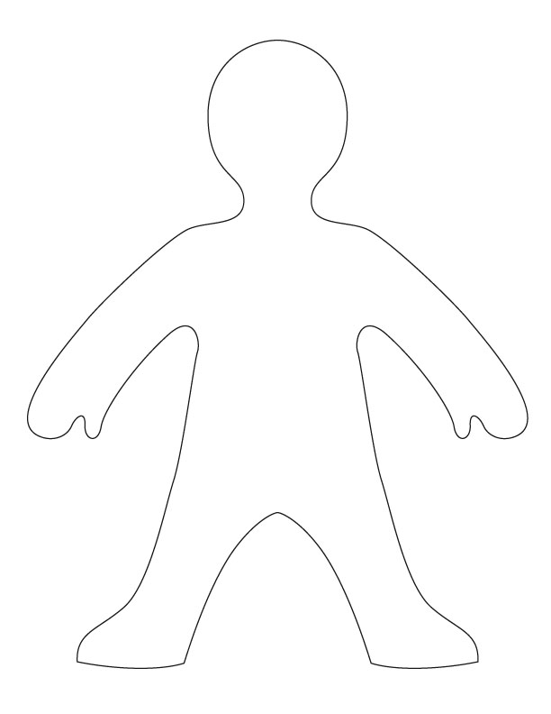

Body mapping
When I am angry I think about the person who hurt me
My cheeks are hot
I can’t stop thinking. It goes around and around
My hands want to punch. They are tight.
I start to feel sick in my stomach.
My hands hurt because my nails are digging in
My feet want to run away
Notes:
Bodily resonance – Gedlin (1979), Shirar (1966) and Stone & Winkelman (1985) – this is not a new concept, but has been adapted following further research.
Supporting disassociation and identification of emotion

Slide 12

Contain the child……
Psychological First Aid: Look, listen, link
https://www.futurelearn.com/courses/psychological-first-aid-for-children-and-young-people
Solihull Approach ‘containment’
https://solihullapproachparenting.com/
Notes:
Containment is ‘where another person receives and understands the emotional communication of another without being overwhelmed by it and communicates this back to the other person. This can restore capacity to think in the other person’. Scripted language ‘I hear you, I understand, you’re angry / hurt. That makes sense given what you have been through’.

Slide 13
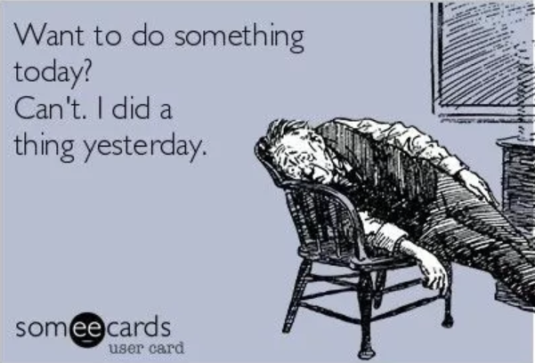
Compassion Fatigue
Notes:
Good Therapy.org describes compassion fatigue as ‘stress resulting from helping, or wanting to help people who are experiencing trauma or suffering.’

Slide 14
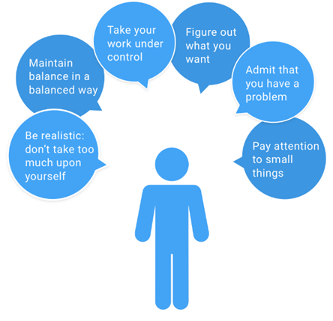
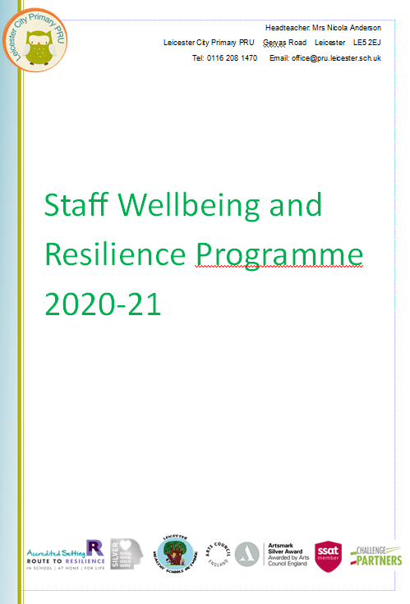
Contain the staff…..
Personal v School / Leadership responsibility??
Self-care.
Staff wellbeing programme: wellbeing Wednesday, wellbeing days off, debrief, supervision, wellbeing questionnaire
NHS 5 steps to wellbeing: connect with other people, be physically active, learn new skills, give to others, be mindful
How full is your bucket?

Slide 15
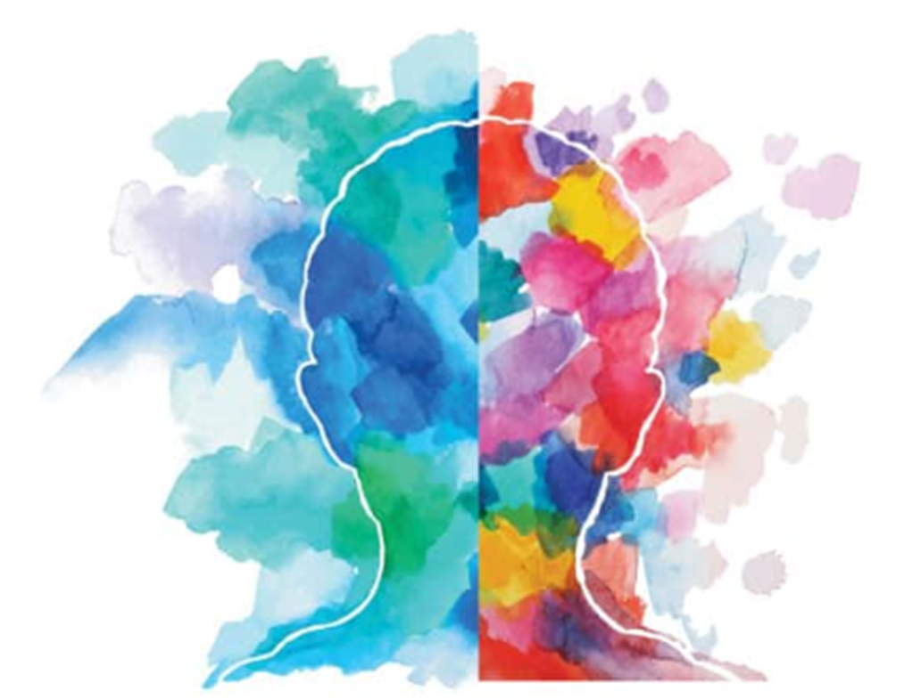
Difficult roads often lead to beautiful destinations!

