Slide 1
The aim of this activity is to allow pupils to reflect and explore ways to respond to a tragic incident or events.
Hopefully, it will also remind pupils that the acts of one group does not reflect the beliefs or practises of the majority.
It should also allow pupils to reflect on positive ways forward following an incident that may disturb or shock them.
(This resource could be used to respond to the current events happening in Palestine and Israel).
Before you get started:
You need to amend the first slide to include details of the incident/ event that you are responding to.
Be willing to discuss thoughts with pupils.
This session requires you to have access to coloured paper or sticky labels.
Main activity
Creating a peace rainbow- pupils use the sentence starters on slide 3 to write responses on coloured paper or sticky notes.
This could make a thoughtful display

Slide 2

Creating a Peace Rainbow
Today you will have an opportunity to:
Reflect on
Explore ways to respond to
Notes:
The aim of this activity is to allow pupils to reflect and explore ways to respond to a tragic incident or events.
Hopefully, it will remind pupils that the acts of a small minority does not reflect the beliefs or practises of the majority.
It should also allow pupils to reflect on positive ways forward following an event that may disturb or shock them.

Slide 3

Creating a Peace Rainbow
My first thoughts about what happened…
My wish for those involved…
We should not blame…
Fairness matters because…
To build trust between communities we can all…
Peace can be created by…
Religious teachings or famous quotes in support of equality…
Notes:
This activity should make a thoughtful display by using different coloured post-it notes for each sentence starter
Discussion about our pathway forward – students complete sentences – important for student well being to explore positive steps forward

Slide 4
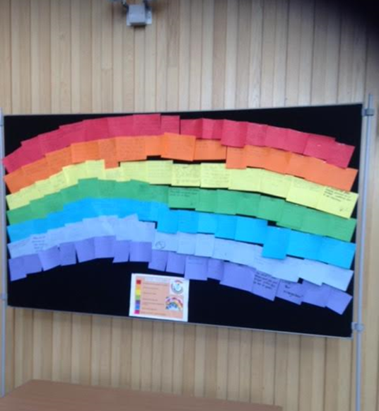
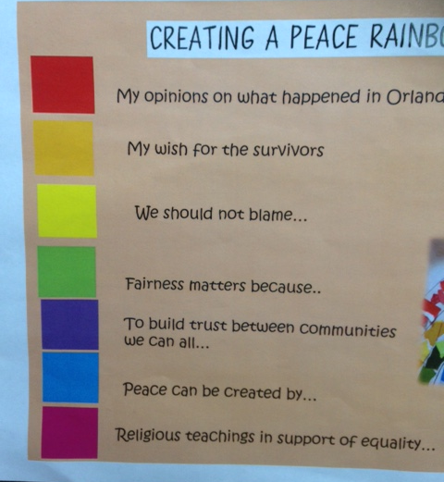
Notes:
This lesson was originally created by the RE department at Titus Salt School in Bradford.

Slide 5
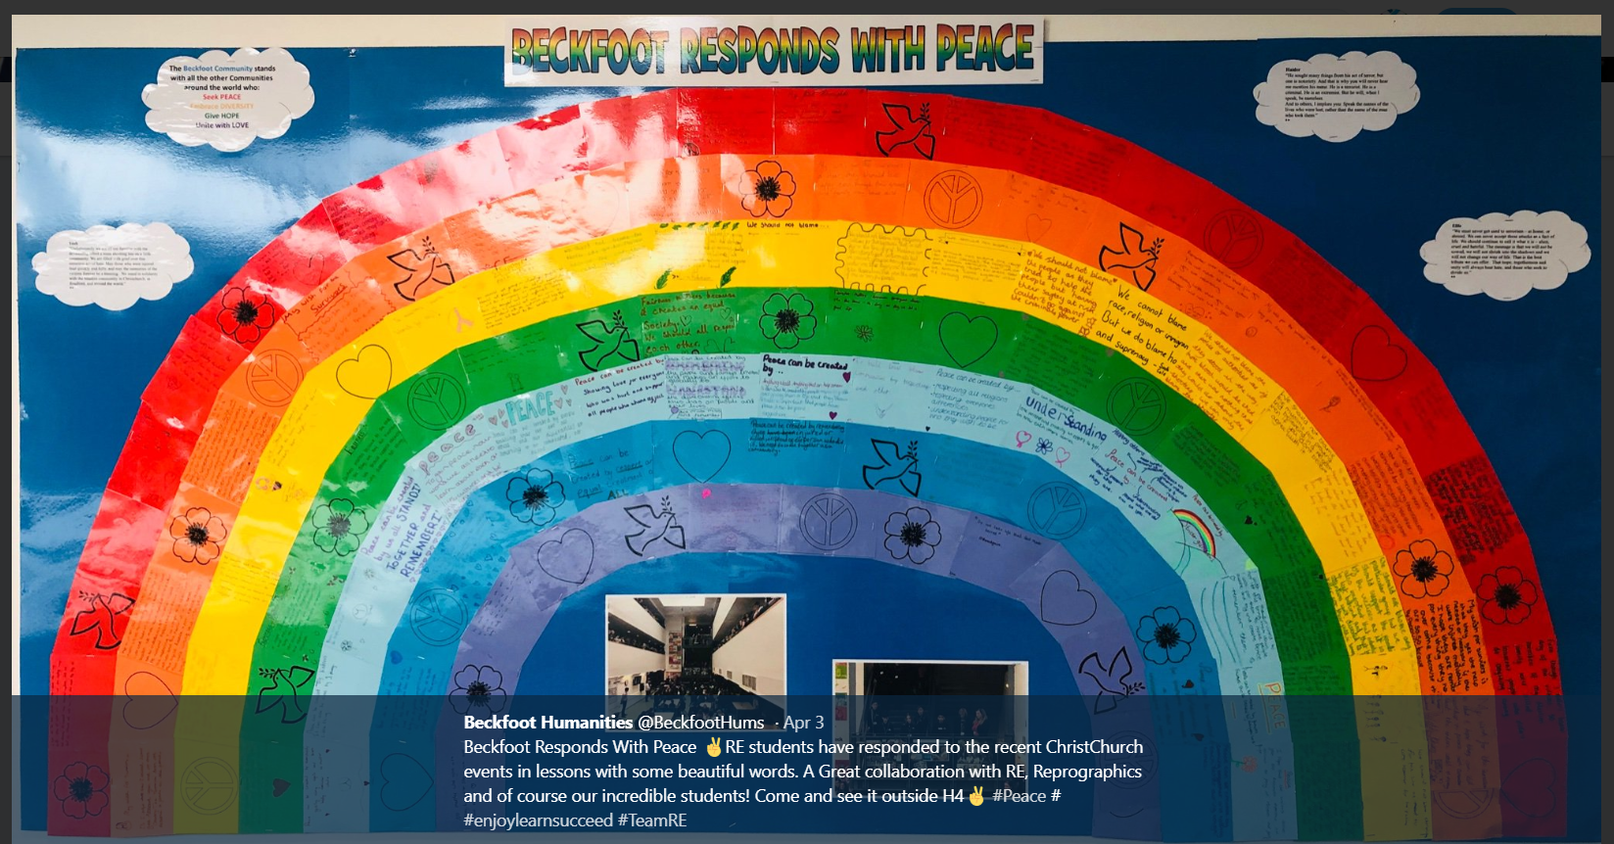
Responding when needed
Peace Rainbow
Notes:
Here is another example from Beckfoot.

Slide 6
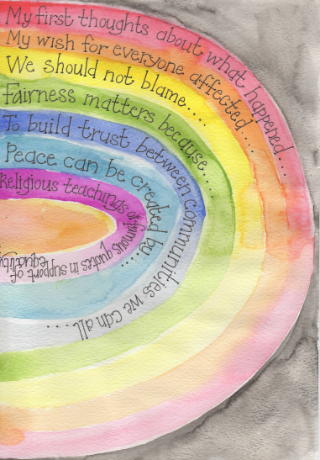
Notes:
Over the next few slides- we have some ideas of how you could create your own individual rainbow …

Slide 7
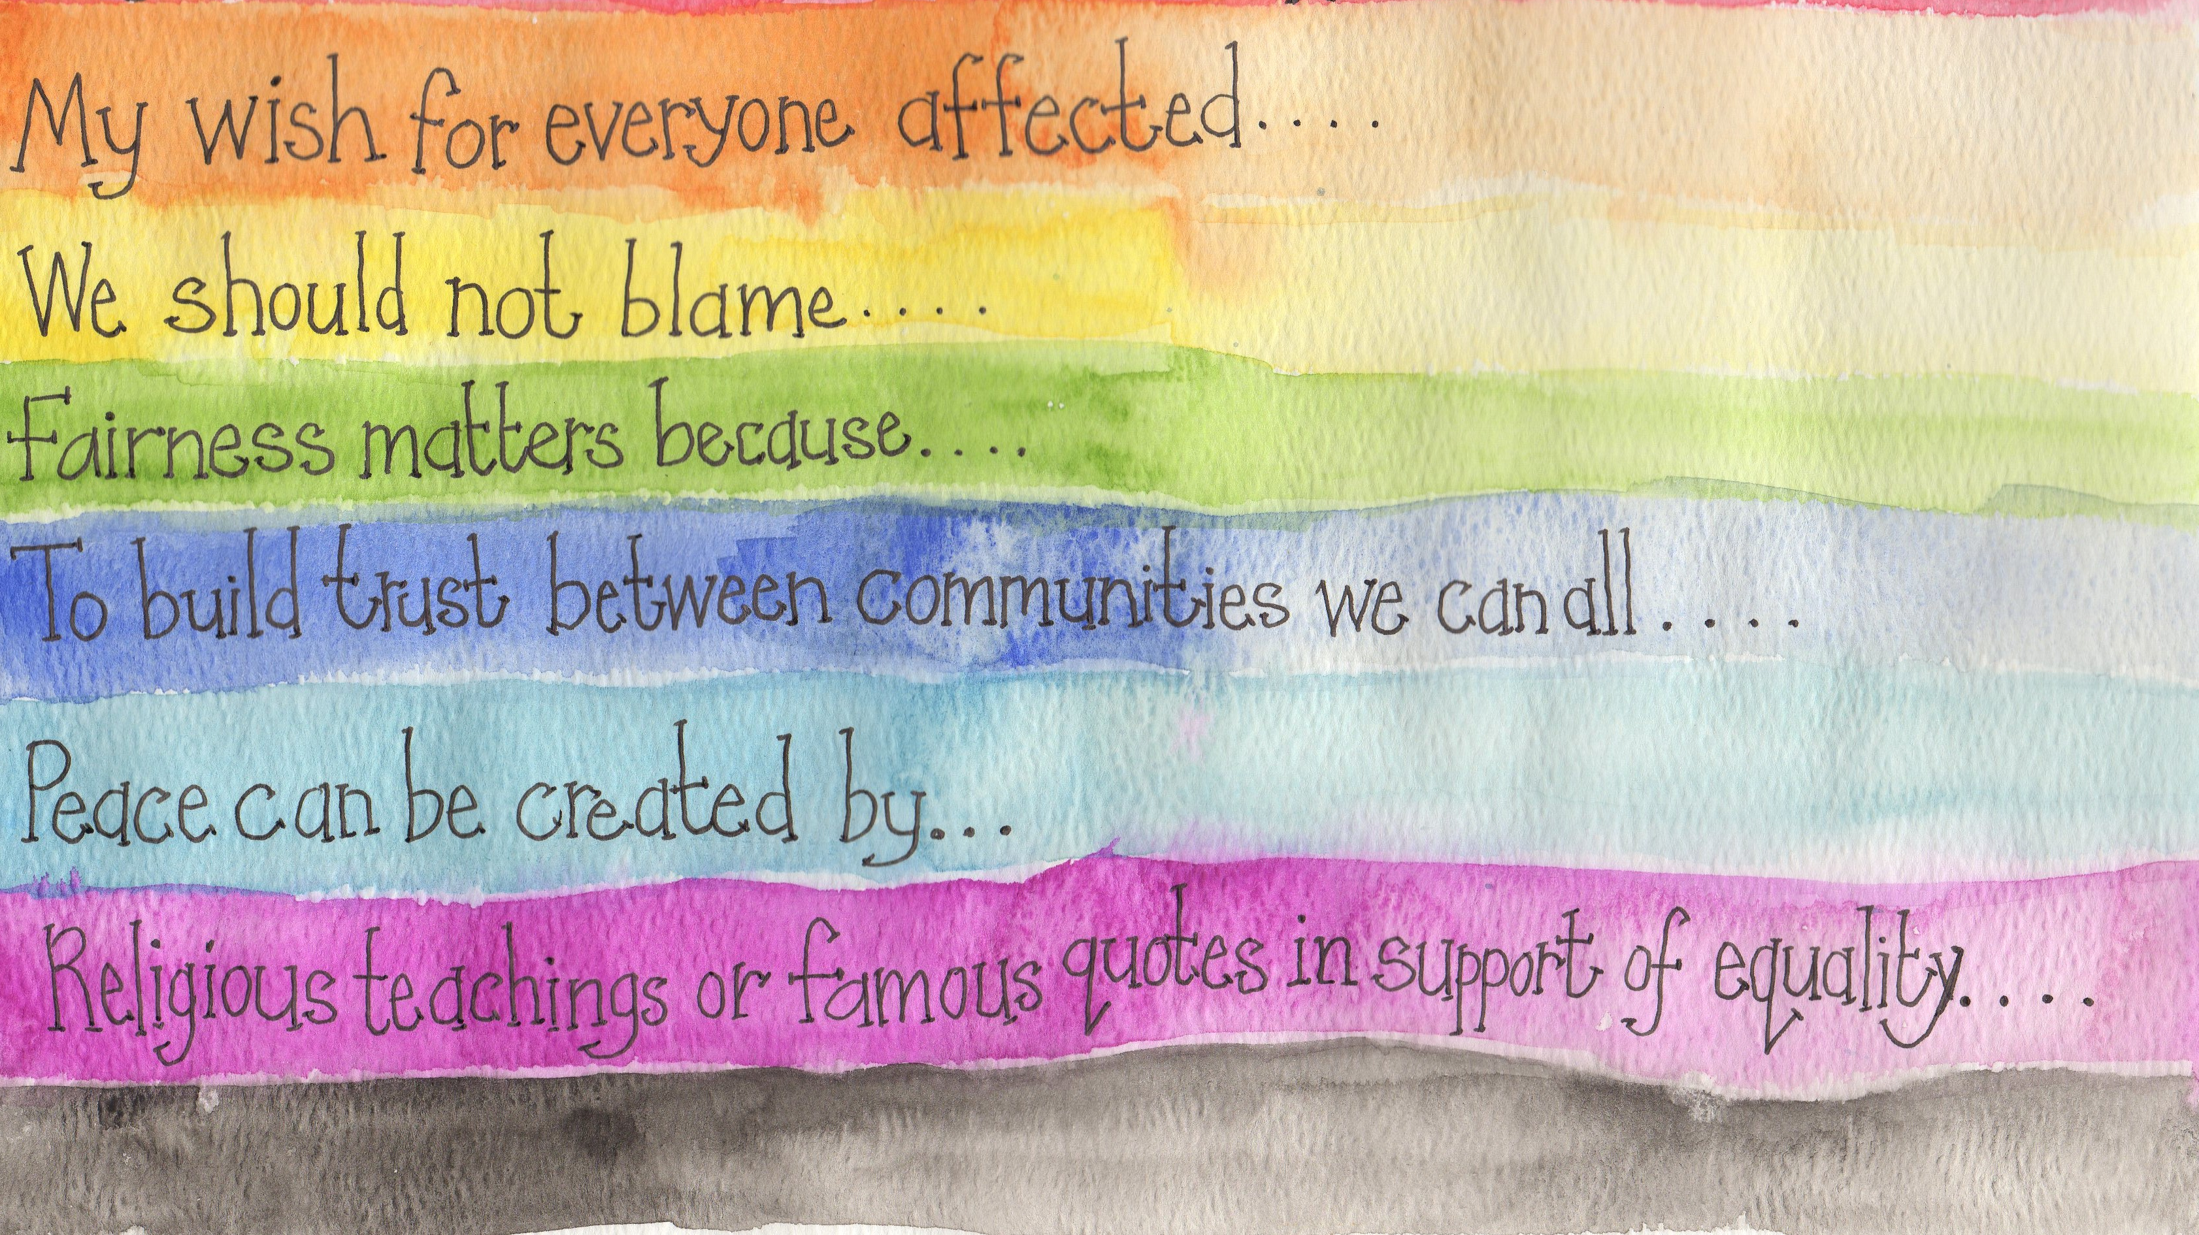
Notes:
Above is an idea of how you could create your own rainbow…the next 2 slides have some blank templates that you could use.

Slide 8




Keep in touch…
You can download this resource and others from:
https://thelinkingnetwork.org.uk
@Linking_Network
@LinkingNetworkFamilyLearning
www.thelinkingnetwork.org.uk
Notes:
You can send your peace rainbow to info@thelinkingnetwork.org.uk and we will be able to share your work with other schools across the country through social media.

