Slide 1
Teacher support info

Slide 2
Vaping in our county
Leicestershire county council have recently conducted a survey around vaping and young people in our county.
The survey was conducted in Nov 2022 and had 1174 responses from young people (15-24 year olds, 64% under 15) across Leicestershire.
Here our some of the key findings:

Slide 3
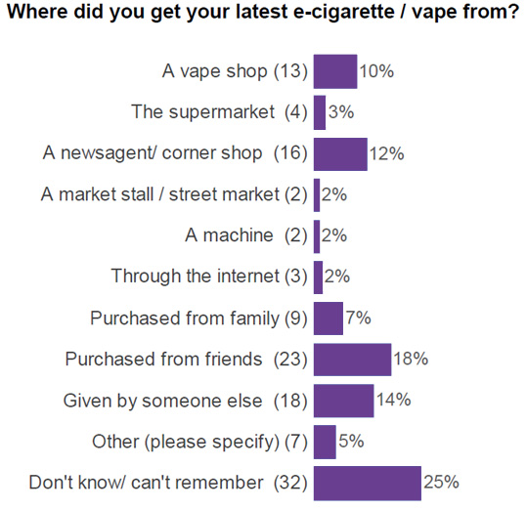

Slide 5
Other:
Stress
I didn’t actually know what it was at the time, I was just handed it and told to try it
Helps with eating habits
Peer pressure
Stress, anxiety
It makes me feel relaxed and calm

Slide 6
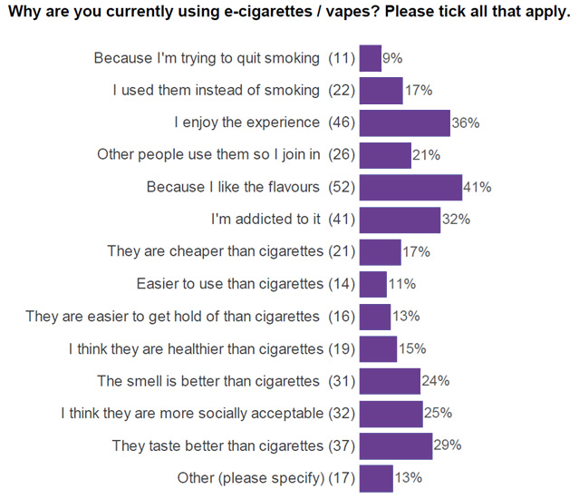
Other:
To relax myself more often
Eating habits
Peer pressure
Addicted to nicotine
Grandma
Stress
Because it makes me feel relaxed and calm
I rarely have them and only ever use other peoples vapes
Helps distract me from stuff
Don’t want me nan to be disappointed in me, I know she’s looking down from heaven right now, praying I follow in her footsteps

Slide 7
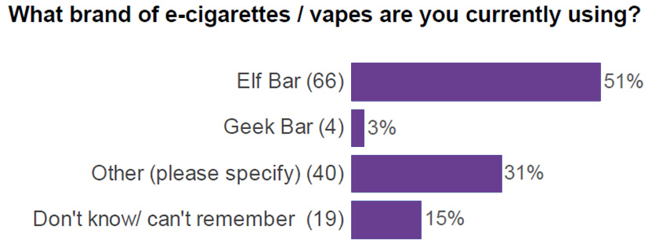

Slide 8
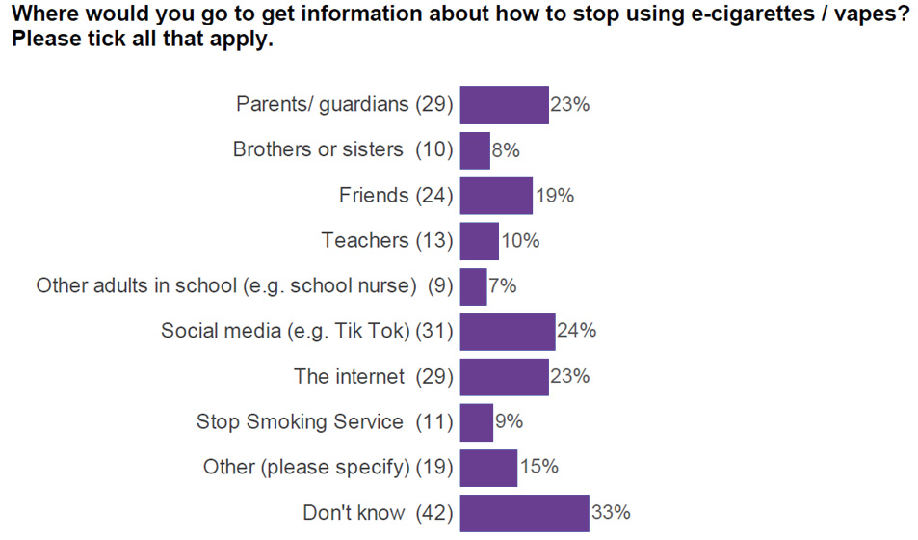

Slide 9
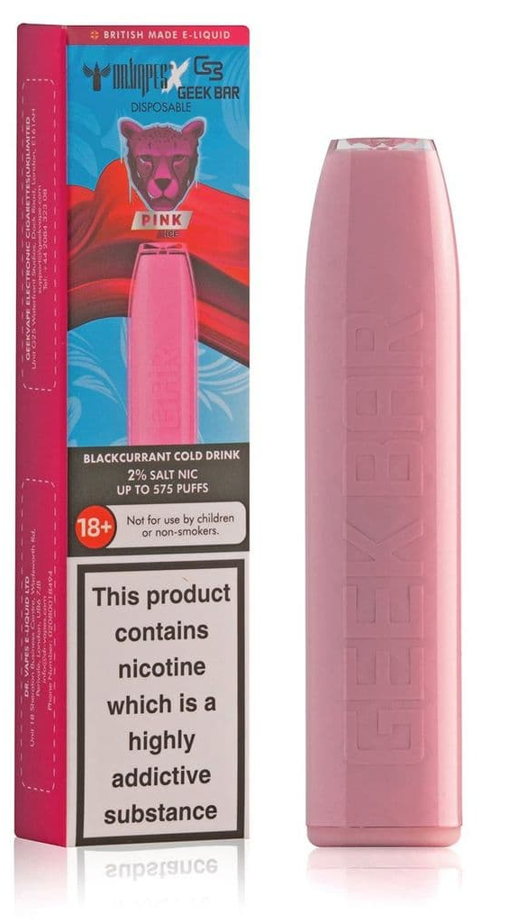
What is a vape and what to look out for
There are a variety of vape devices (which are also known as e-cigarettes). The names and type of devices keep changing and new ones come on to the market frequently. Below are the main types of vapes currently available:
Geek bars
Elf bars
Rechargeable vape pens with batteries
Cigalikes

Slide 10
Laws around young people and vaping
Vapes and vaping products containing nicotine, like tobacco, are age restricted. It’s illegal to sell them to under 18s, and for adults to buy them on their behalf.
Those who knowingly sell vapes to under 18s don’t care who they sell to and they are just interested in making money.
If you know of anyone who does sell vapes, or tobacco illegally, you can report them to trading standards through the Citizens Advice online portal: www.citizensadvice.org.uk/consumer/

Slide 11
Resources and support services
Quit Ready Stop Smoking Service for help to quit smoking www.quitready.co.uk/
ASH https://smokefreesheffield.org/get-involved/campaigns/vaping-the-facts/
NHS live better www.nhs.uk/live-well/quit-smoking/using-e-cigarettes-to-stop-smoking/

